Slide 1
Connecting MongoDB with the website
Section End Project

Slide 2
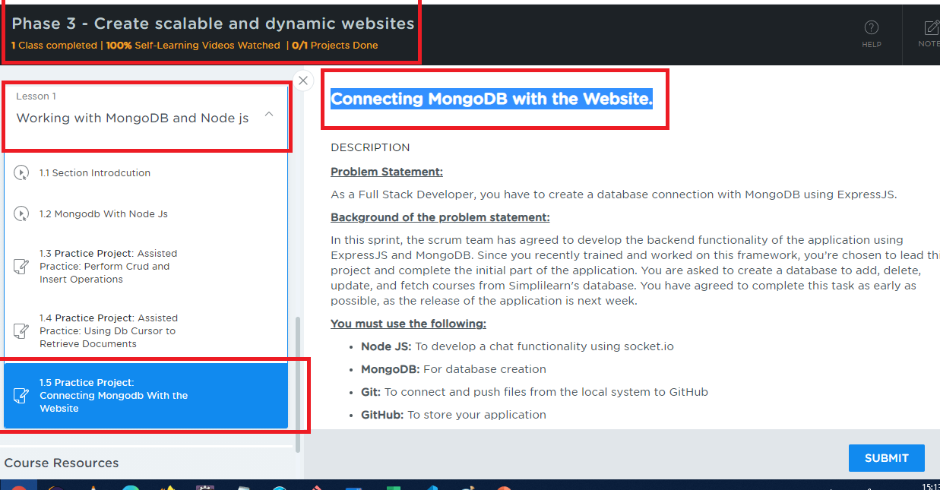
Project Location
Choose Phase3, select the section 6, lesson 1, scroll down to end you will get 1.5 Practice project

Slide 3
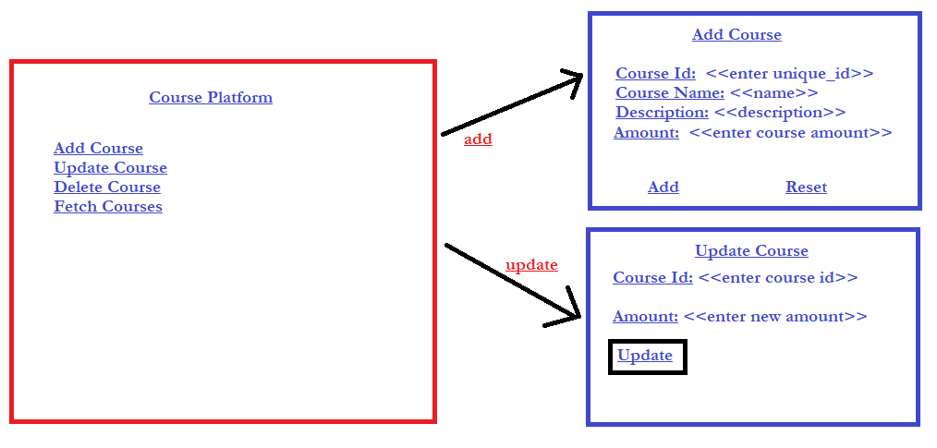
Project Implementation

Slide 4
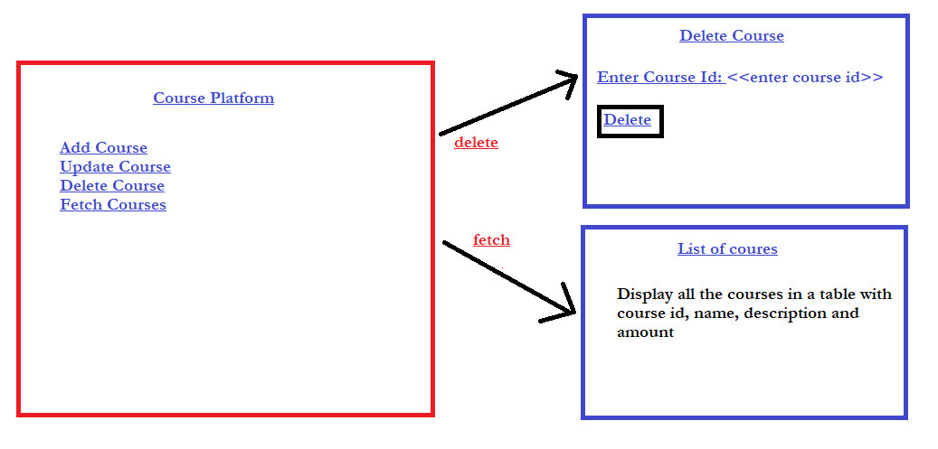
Project Implementation

Slide 5
Project Implementation
All the courses you add should be stored in MongoDB
As of now you can enter the course id manually but ensure it’s unique as it is part of _id value
Don’t waste time on the designing of the page
The UI template given is to understand the requirement, you can implement in different ways however the operations like add, update, delete and fetch must be present
Validating the wrong id’s for update and delete is not mandatory
Validating duplicate id’s while adding the course is not mandatory

Slide 6
Important things to consider while submitting
Write Up
Don’t push the document into the Git repository, use .gitignore file
Better create separate folder for the project inside the git repository
Mention the Git repo link in the document
Mention the folder name that has project in the document
Give brief information about the source code files to make us understand what is the purpose of the file in the document.
EX: index.html is the main page which has links to Home, Services, Contacts
EX: styles.css is the style sheet that is used to design web page
EX: myscripts.ts is the typescript code which has functions like search() to search the data

Slide 7
Important things to consider while submitting
Screenshot
Add the screen shot of the project output
You are allowed to add multiple screen shots in case required
Source Code
Wrap all the source codes like html, css, js, ts, etc in a zip
Upload the zip
If in case zip is not supported you can attach all source codes one by one
Note:
While pushing the project in Git repository you can have all your assignments and projects in a single repository
Create separate folders for each project in the Git repository, however you can mention these folder names in the document

Slide 8
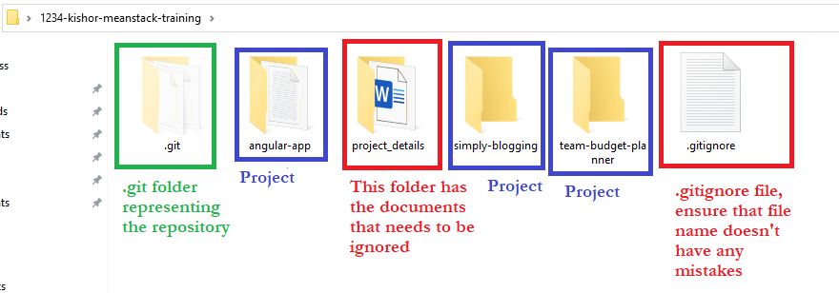
How to ignore document not to track in git
Create a folder in the repository with some name, e.g., project_details, keep all the documents inside this folder
Open .gitignore file and add the folder name entry as project_details/
Below is a screenshot of the local repository to understand where to keep .gitignore file, notice its inside the repository 1234-kishor-meanstack-training

Slide 9
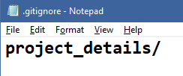
Adding the project_details folder entry inside .gitingore file
Open .gitignore file and add the folder project_details that has all the documents explaining each project
When you enter git status you can notice that project_details folder wouldn’t be tracked

